Slide 1
Evolutionary Computation
in Continuous Optimization and Machine Learning

Slide 2
Introduction
What? Why? How?

Slide 3
Introduction: Concepts
Optimization
Evolutionary Computation
Problem solving using natural computational processes
Darwinian evolution as a model for solving optimization problems
“Organisms” as “inputs” to the model of the “environment”
Notes:
Faster on this one

Slide 4
Introduction: Purpose
Benchmark of Optimization
New Algorithm
Three emerging evolutionary algorithms
On mathematical functions
On machine learning tasks
Improve on the three algorithms in some respects in machine learning
Add it to the benchmark

Slide 5
Background
Introduction to EA, Traditional EA, Emerging EA, Machine Learning

Slide 6
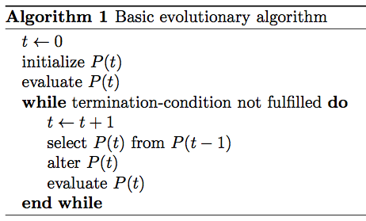
Evolutionary Algorithms: Introduction
Works with populations
Which contain individuals
Which are parameter vectors
Notes:
Faster

Slide 7
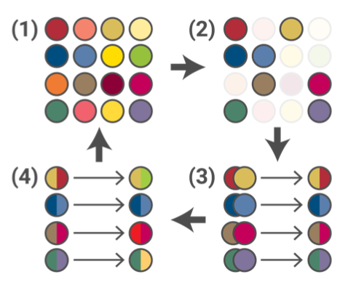
Evolutionary Algorithms: Terminology
Population
Representation
Initialization
Parent selection
Variation
Survivor selection
Fitness function
Termination condition
Notes:
Faster

Slide 8
Evolutionary Algorithms: Varieties
Traditional
Emerging
Genetic Algorithms
Evolution Strategy
Evolutionary Programming
Genetic Programming
Differential Evolution
Particle Swarm Optimization
Estimation of Distribution Algorithm

Slide 9
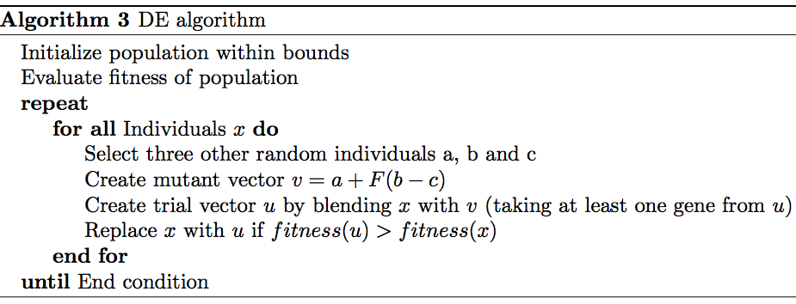
Differential Evolution
Mutation based on vector differences
Few parameters
Easy to implement
Very good overall

Slide 10
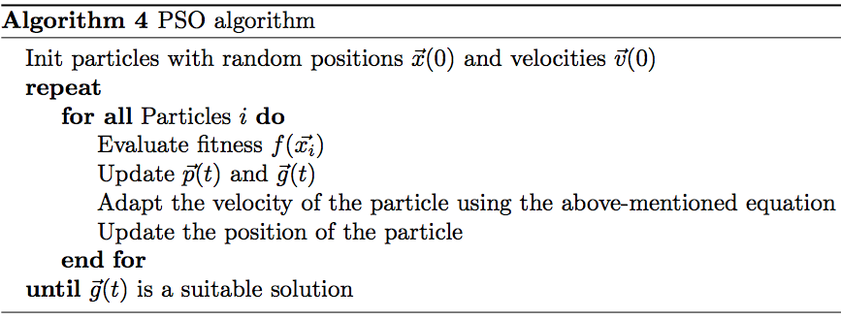
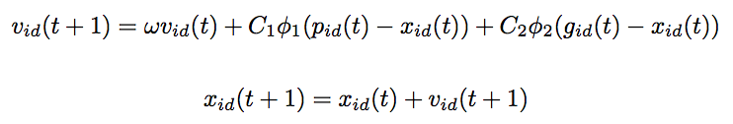
Particle Swarm Optimization
Population forms a swarm which acts as a whole
Individuals explore the terrain but follow to the swarm
Update formula guides the movements

Slide 11
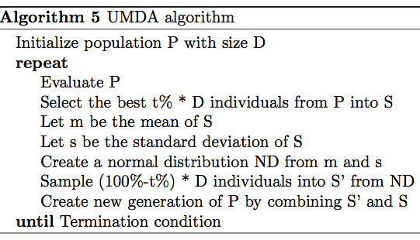
Estimation of Distribution Algorithm
Mutation accomplished by sampling probability models
Choice of model depends on the complexity of the problem
Simplest is normal distribution

Slide 12
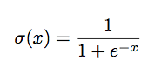
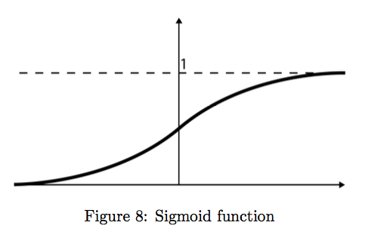
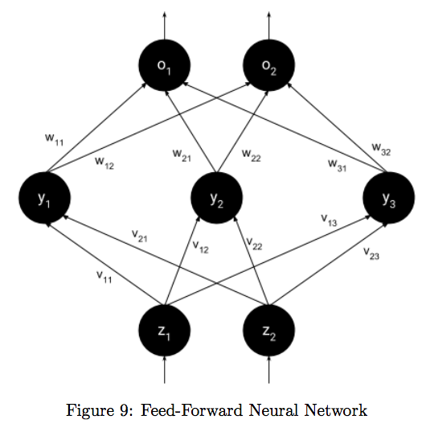
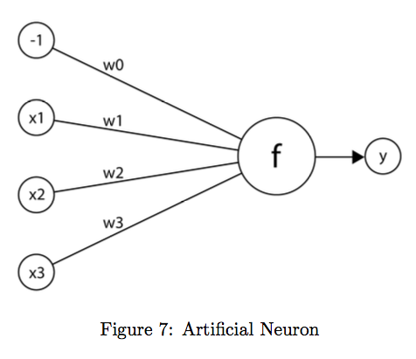
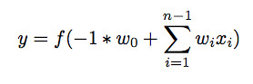
Machine Learning
Artificial Neural Networks
Feed-Forward Neural Network
Back-propagation
Notes:
Faster

Slide 13
Related Work
Current Research, Emerging EA, ML and the Contribution

Slide 14
Research
Roots
Current Research
First ideas in 1950s
Several concepts emerged independently
Genetic Algorithms
Evolution Strategy
Evolutionary Programming
No free lunch means no single algorithm can beat them all
Parallelism
Multi-population models
Multi-objective optimization
Dynamic environments
Evolving executable code
Notes:
Faster

Slide 15
Research: Differential Evolution
Created 1995 by Storn and Price
One of the best algorithms in continuous optimization
Hybridization (self-adaptive, opposition-based, with local and global neighborhoods)
Effects of parameter use well studied
Comes in 10 different varieties (DE/best/1/bin generally one of the best)

Slide 16
Research: Particle Swarm Optimization
Most popular swarm optimization algorithm
Modified versions (quantum-behaved, bare-bones, chaotic, fuzzy, PSOT-VAC, opposition-based)
Hybridized with other evolutionary algorithms
Differential Evolution

Slide 17
Research: Estimation of Distribution Algorithm
Different probabilistic models have been tried (normal distribution, Gaussian nets, graphical models, etc.)
Successful at many engineering problems which other algorithms struggle with (antenna design, protein prediction, portfolio management, chemotherapy, etc.)
Improvements
Parallelization of fitness function and model building
Local optimization techniques (hill climbing)

Slide 18
Research: Machine Learning
Many attempts to combine ML and EA
ML used to improve EC
EC used to improve ML
Differential Evolution optimizing neural networks
Particle Swarm Optimization initializing weights in neural networks

Slide 19
Contributions
Studying the application of evolutionary computation on machine learning
Finding the best optimization algorithms for machine learning tasks
Contributing a novel improved algorithm

Slide 20
Problem Formulation
Questions, Motivation, Outcomes and Limitations

Slide 21
Questions
How do the emerging algorithms compare on mathematical benchmarks?
How do the emerging algorithms compare on machine learning benchmarks?
Which algorithms are best suited for which problems?
How can the algorithms be improved?

Slide 22
Motivation
Insight into application of evolutionary computation on popular machine learning tasks
Improved algorithms for machine learning
Comparison of algorithms

Slide 23
Outcomes
Benchmarks
Mathematical
Machine Learning
Function Approximation
Clustering
Classification
Game Controllers
Improved algorithm

Slide 24
Limitations
Limited number of algorithms
Limited number of variants of algorithms
Small number of test cases

Slide 25
Method
The How

Slide 26
Method
Benchmark
Algorithm
Statistical approach with multiple measurements
Code written and developed in Matlab
Experimental iterative development process
Code written and developed in Matlab
Notes:
Faster

Slide 27
The Proposed Algorithm
Differential Estimation of Distribution

Slide 28
The Proposed Algorithm
Improve upon Estimation of Distribution
Add a second variation model inspired by Differential Evolution

Slide 29
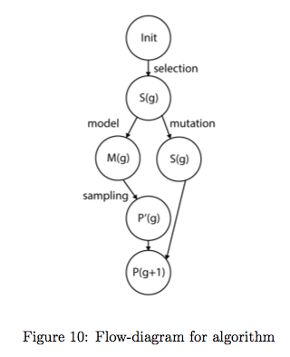

Slide 30
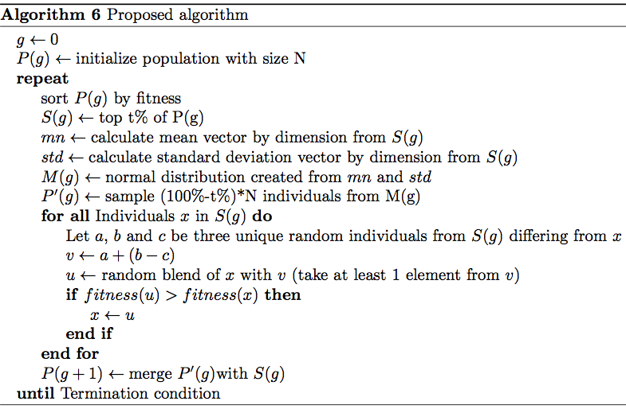

Slide 31
Experimental Results and Evaluation
Mathematical Benchmark, ML Benchmark, Results, Discussion

Slide 32
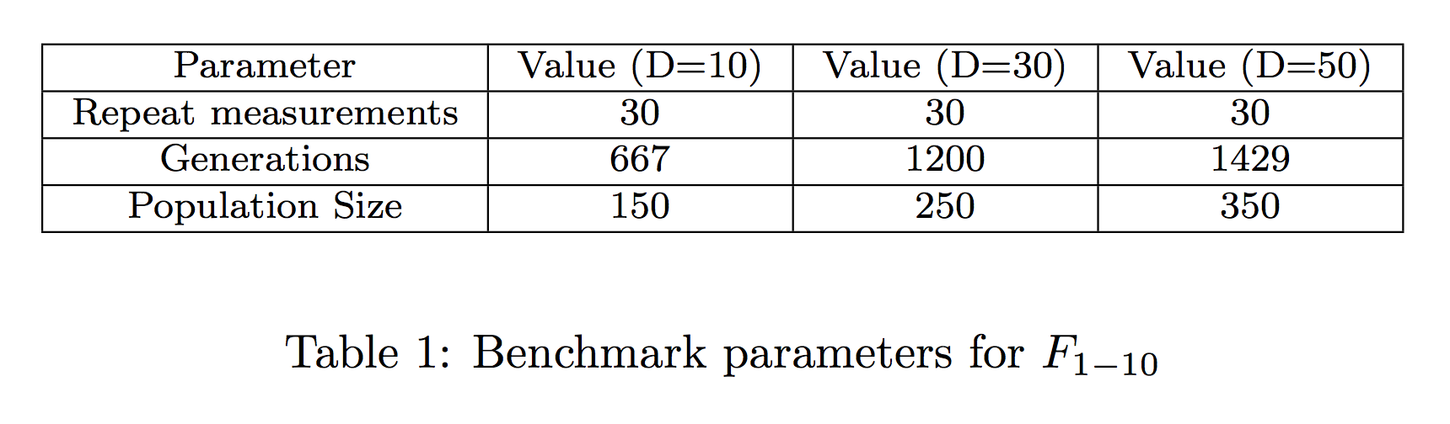
Mathematical Function Optimization
2005 CEC competition test bed
Based on popular De Jong test-bed
Repeat measurements
At dimension 10, 30 and 50

Slide 33
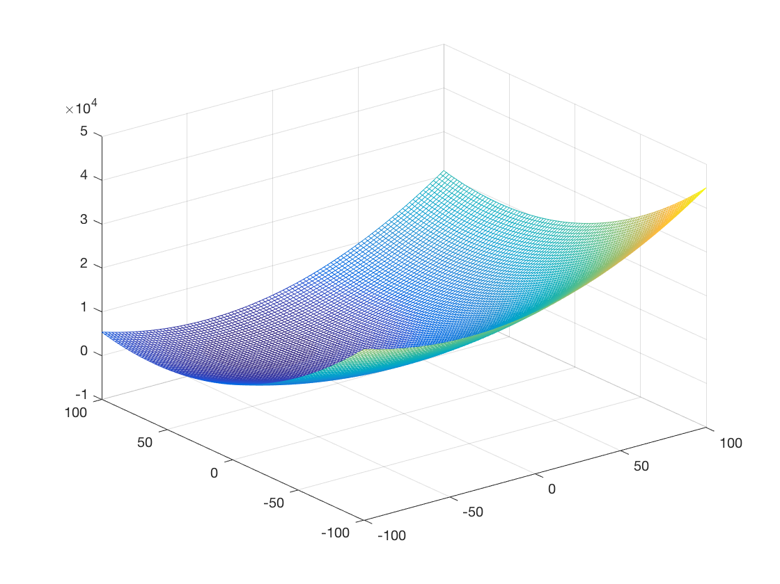
F1: Shifted Sphere Function
Unimodal
Separable

Slide 34
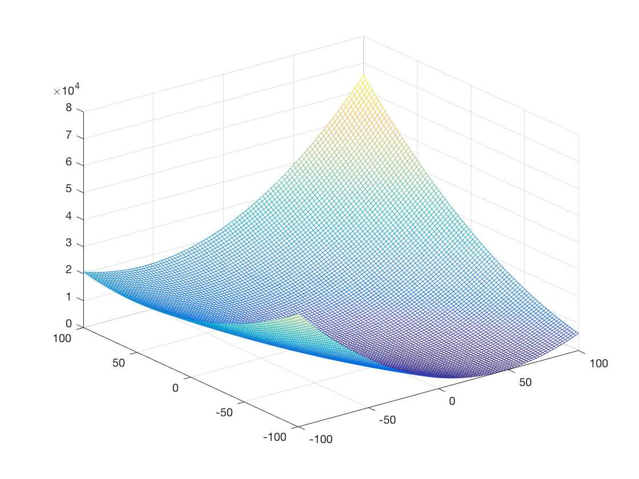
F2: Shifted Schwefel’s Problem
Unimodal
Non-Separable

Slide 35
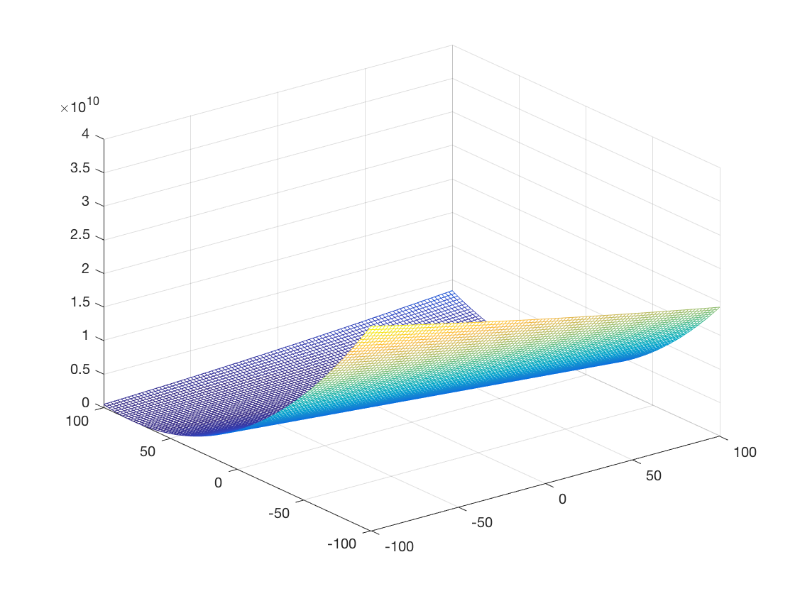
F3: Shifted Rotated High Conditioned Elliptic Function
Unimodal
Non-Separable

Slide 36
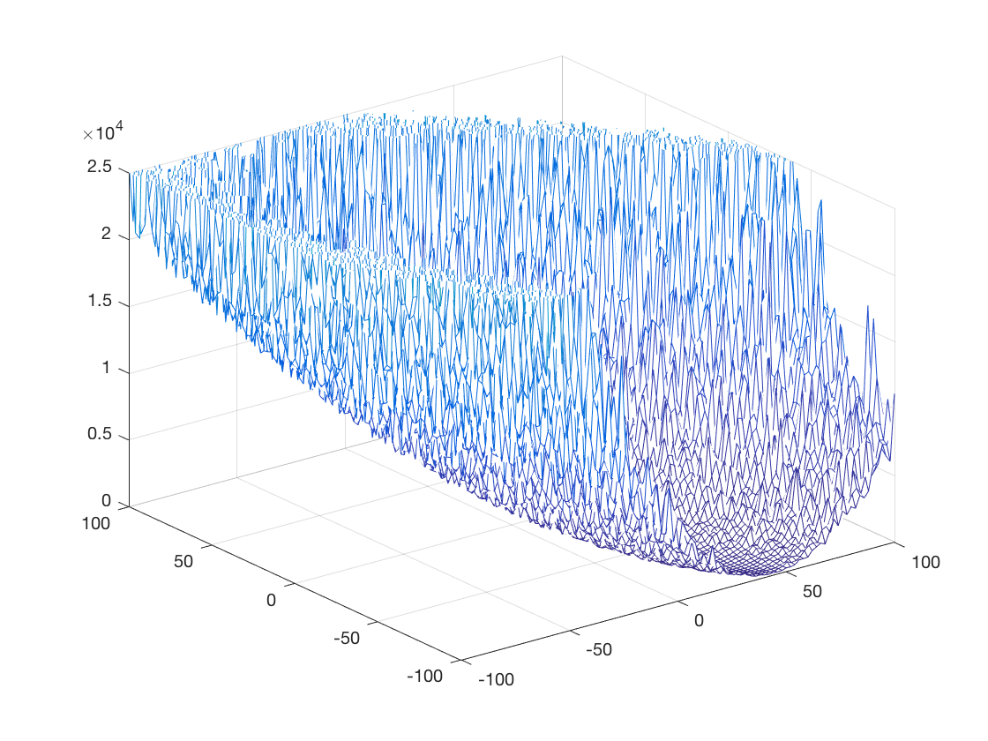
F4: Shifted Schwefel’s Problem with Noise in Fitness
Unimodal
Non-Separable

Slide 37
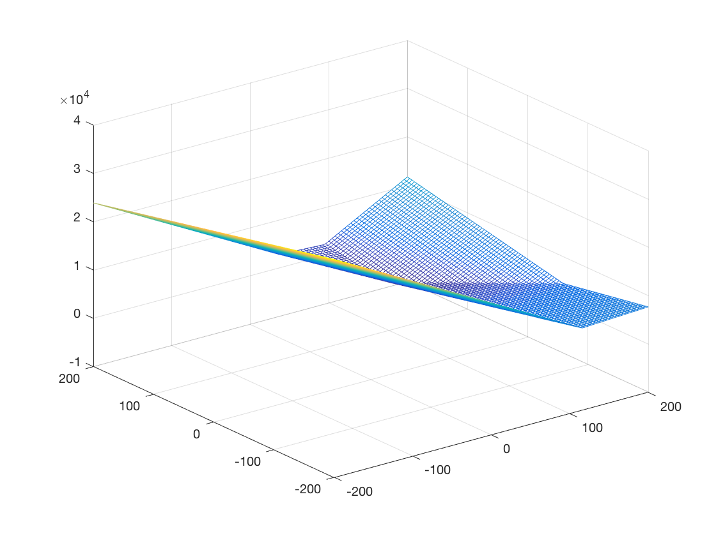
F5: Schwefel’s Problem with Global Optimum on Bounds
Unimodal
Non-Separable

Slide 38
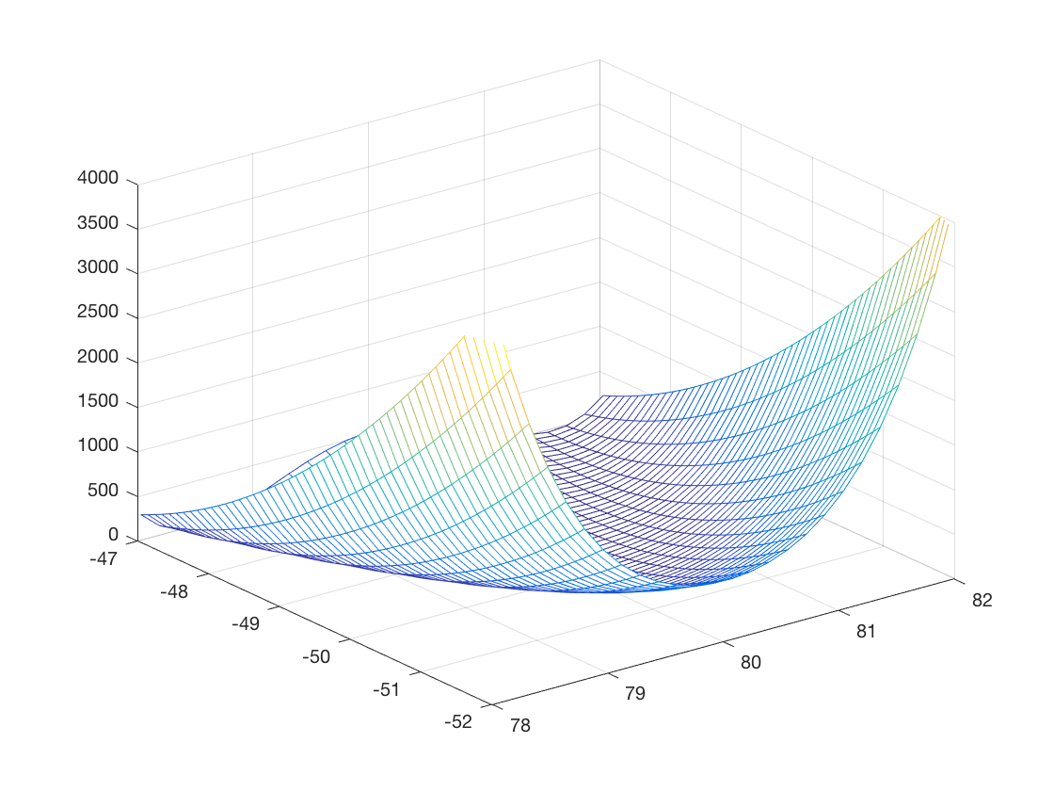
F6: Shifted Rosenbrock’s Function
Multimodal
Non-Separable

Slide 39
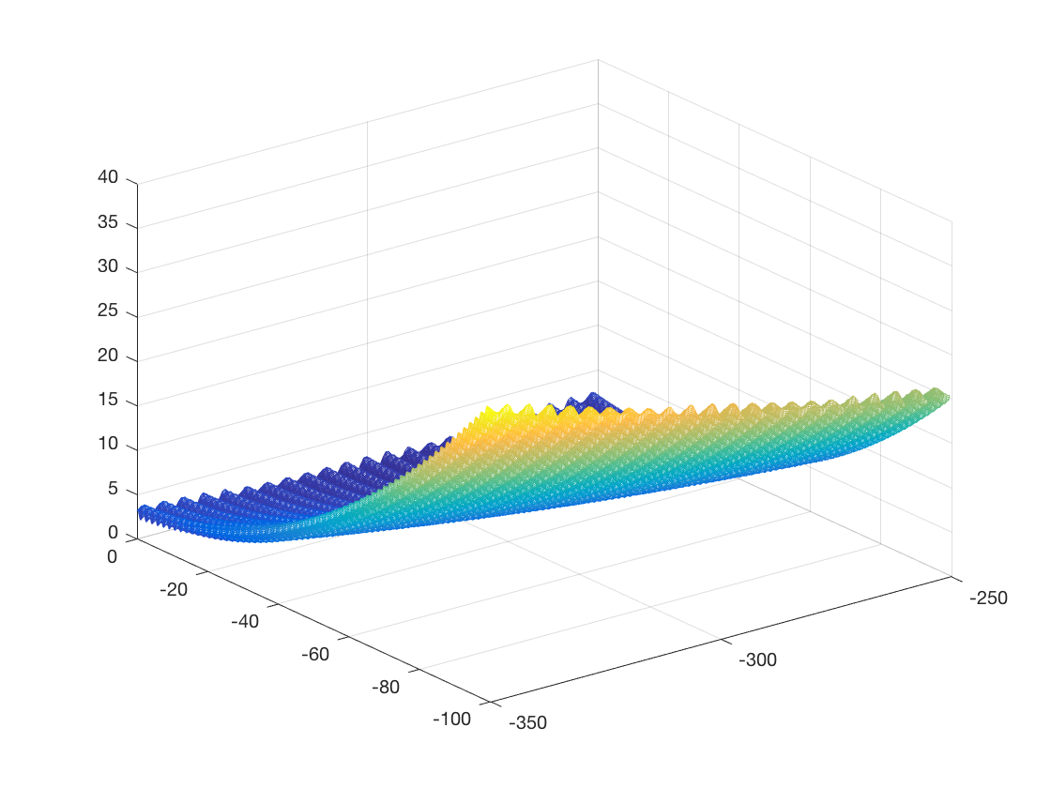
F7: Shifted Rotated Griewank’s Function without Bounds
Multimodal
Non-Separable

Slide 40
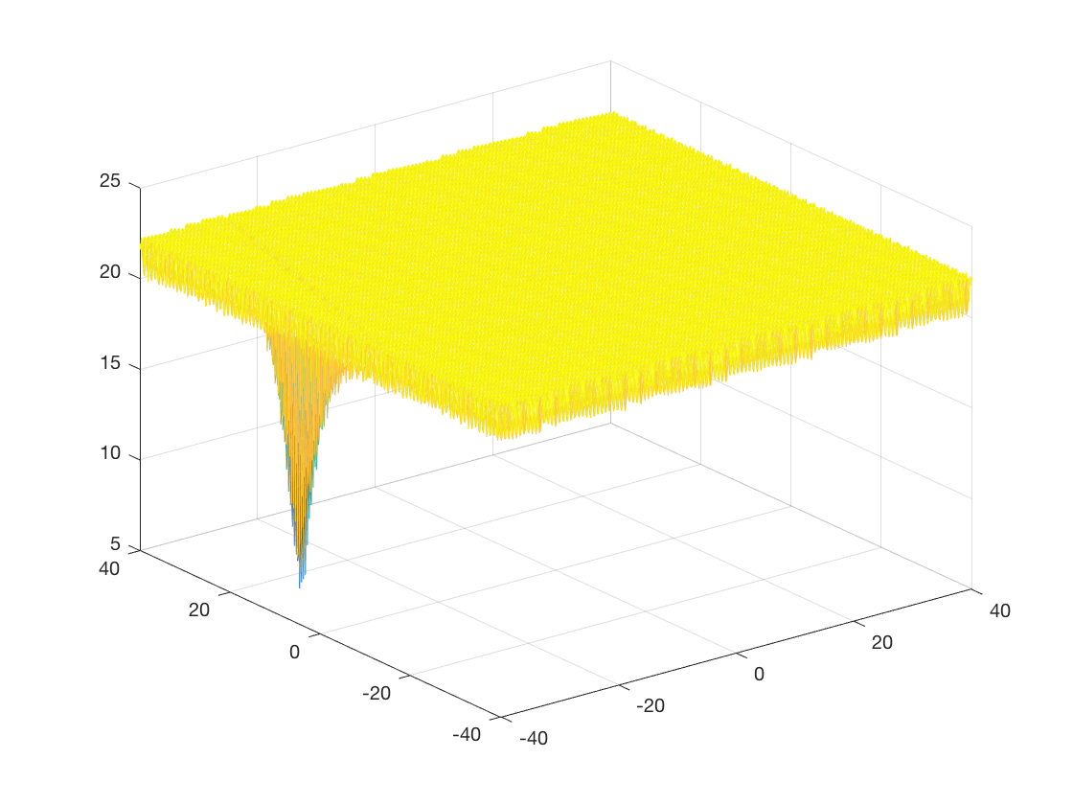
F8: Shifted Rotated Ackley’s Function with Global Optimum on Bounds
Multimodal
Non-Separable

Slide 41
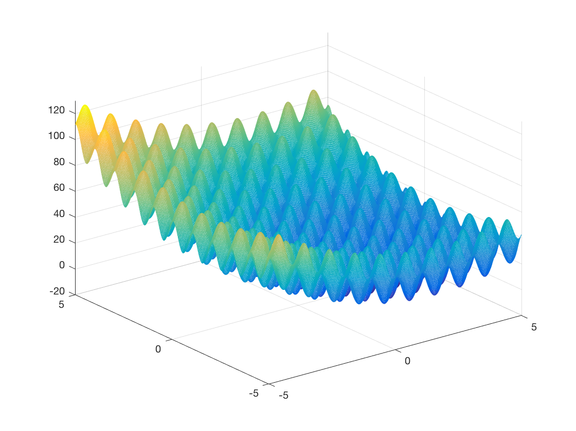
F9: Shifted Rastrigin’s Function
Multimodal
Separable

Slide 42
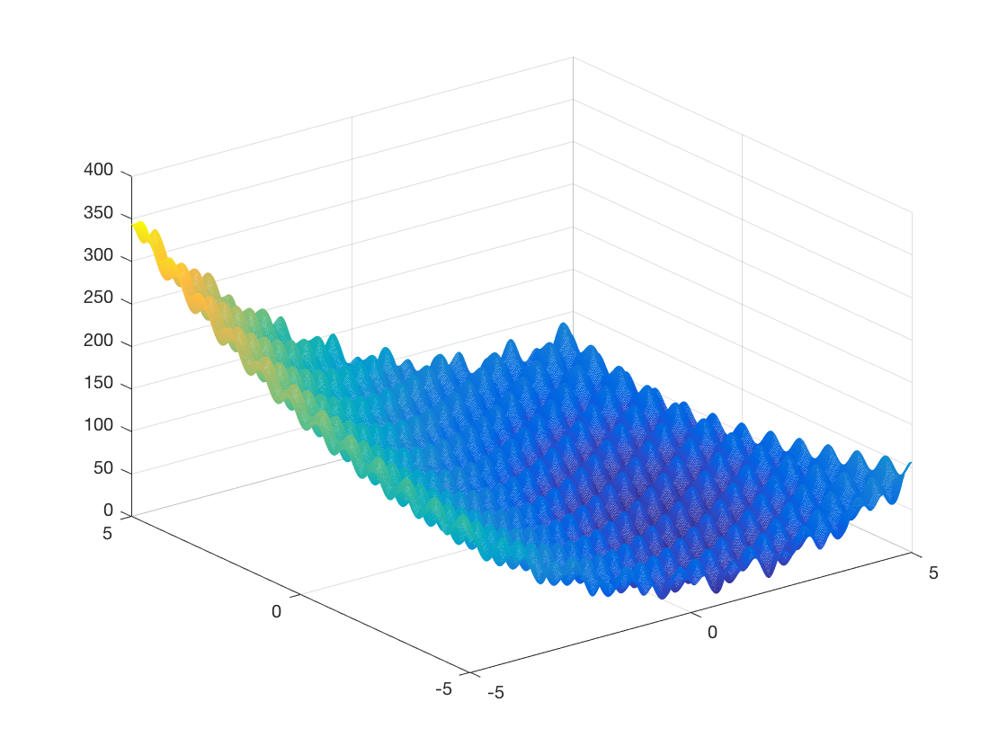
F10: Shifted Rotated Rastrigin’s Function
Multimodal
Non-Separable

Slide 43
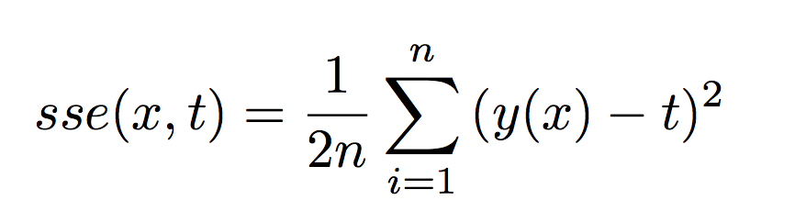
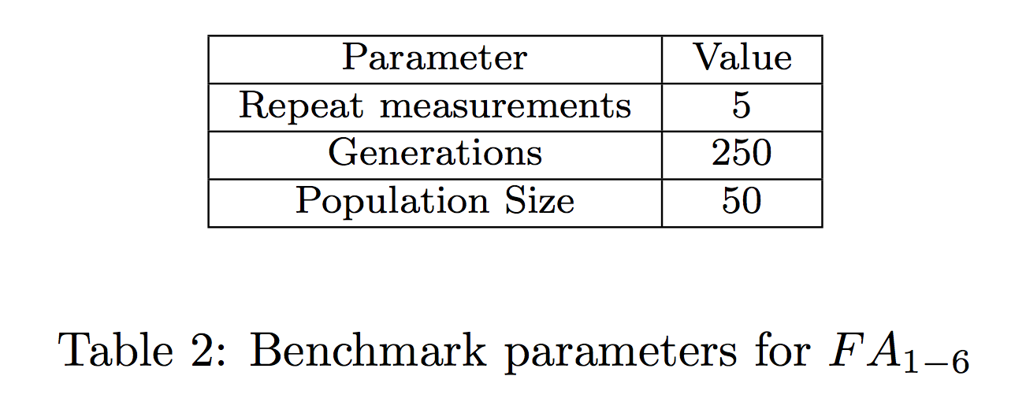
Function Approximation
Training Feed-Forward Neural Networks to perform function optimization
Matlab sample data-sets were used
Repeat measurements
Sum of squared errors (SSE) used as fitness function

Slide 44
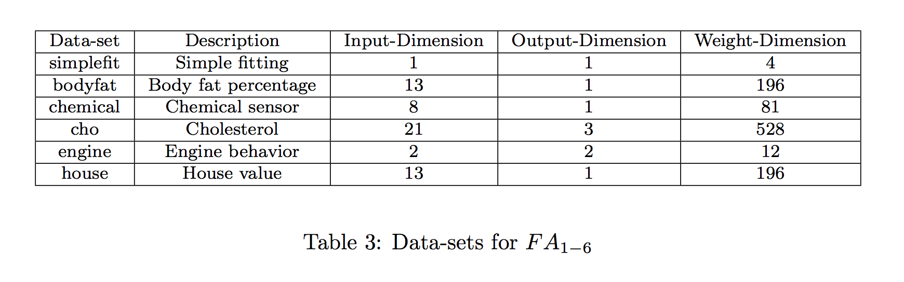

Slide 45
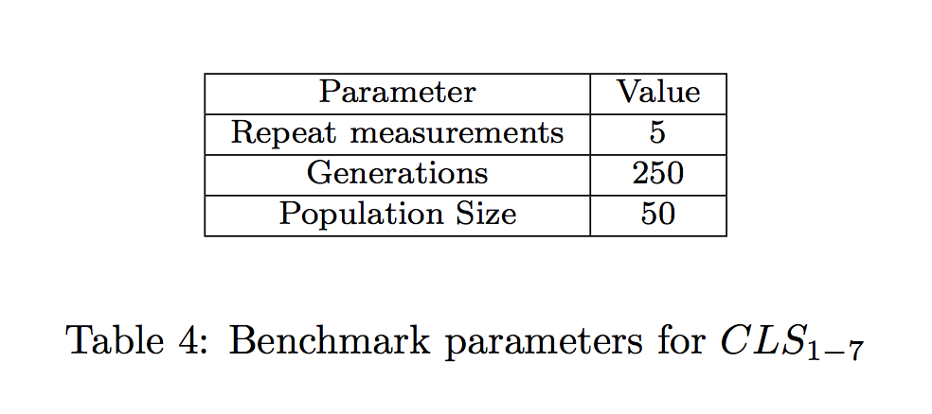
Classification
Training Feed-Forward Neural Networks to perform classification
Matlab sample data-sets were used
Repeat measurements
Sum of squared errors used as fitness function

Slide 46
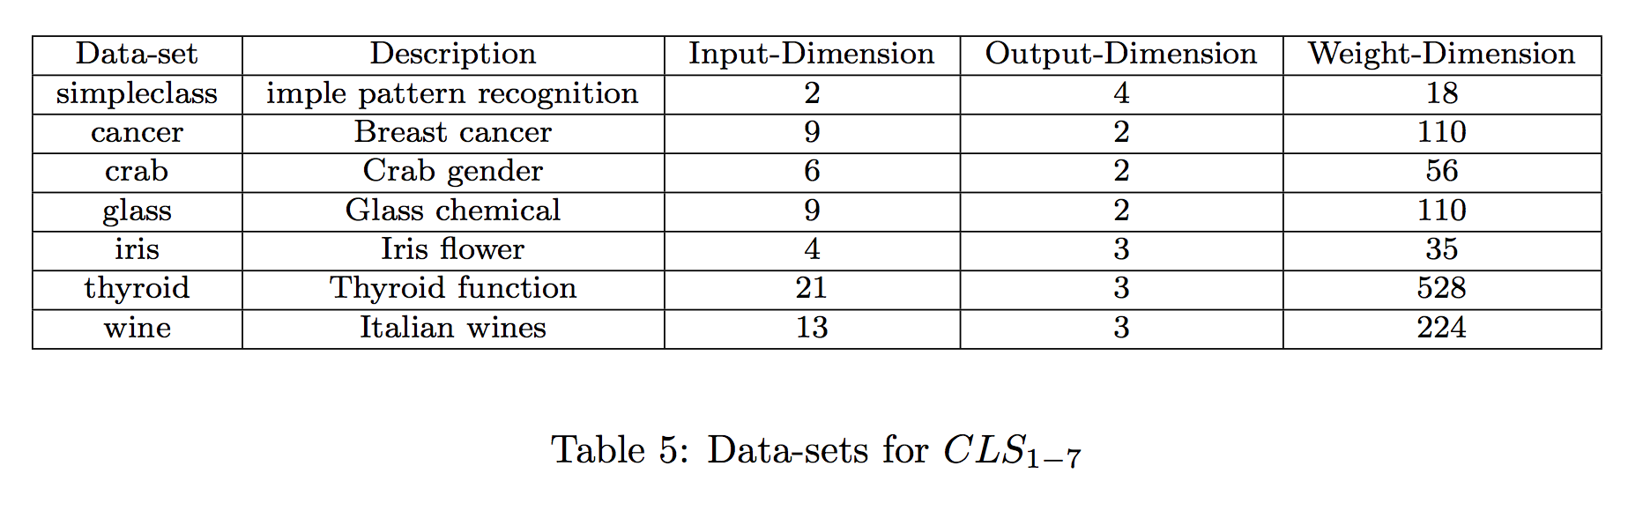

Slide 47
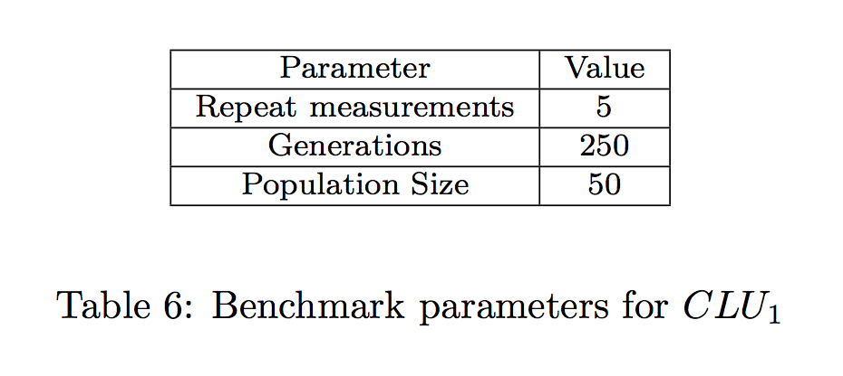
Clustering
Training Feed-Forward Neural Networks to perform clustering
Matlab sample data-sets were used
Repeat measurements
Sum of squared errors used as fitness function

Slide 48
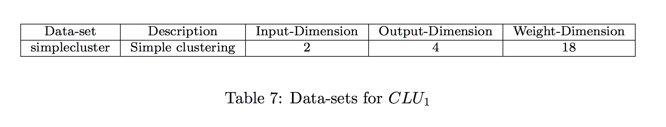

Slide 49
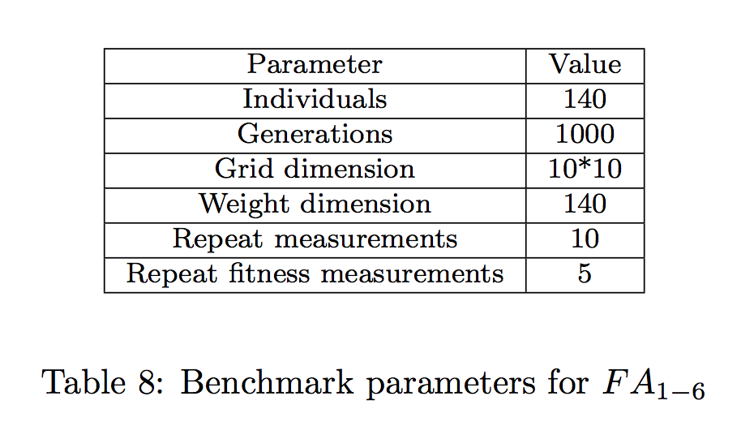
Intelligent Game Controller
Training Feed-Forward Neural Networks to control classic game of “Snake”
12-dimensional vector represents the snakes senses
4-dimensional vector represents the decision matrix
Notes:
Faster

Slide 50
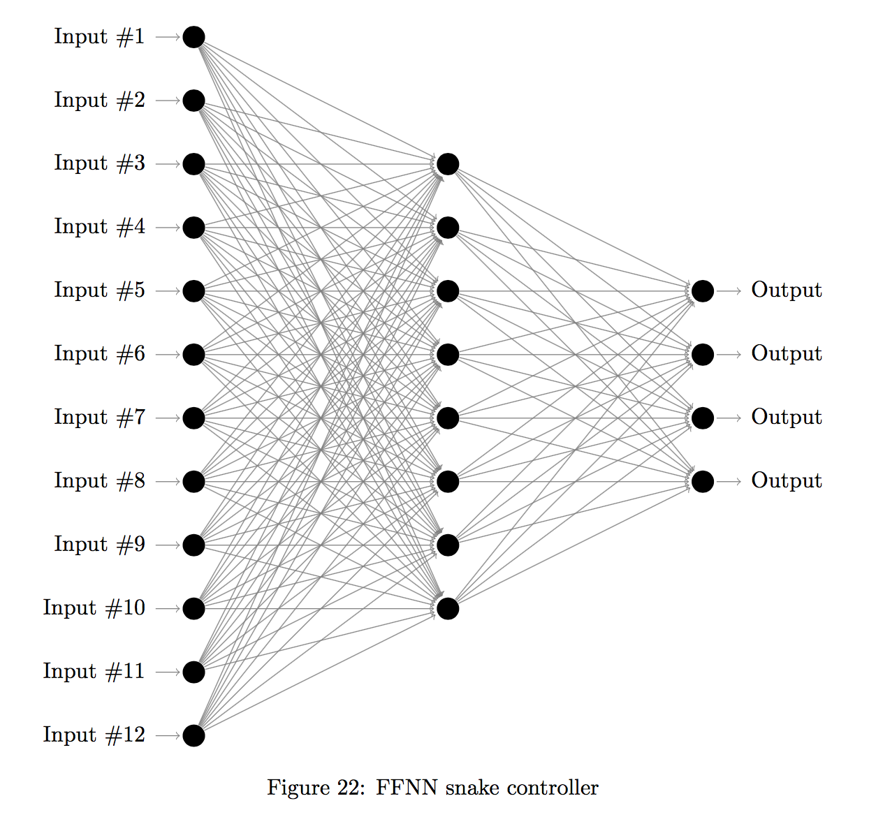
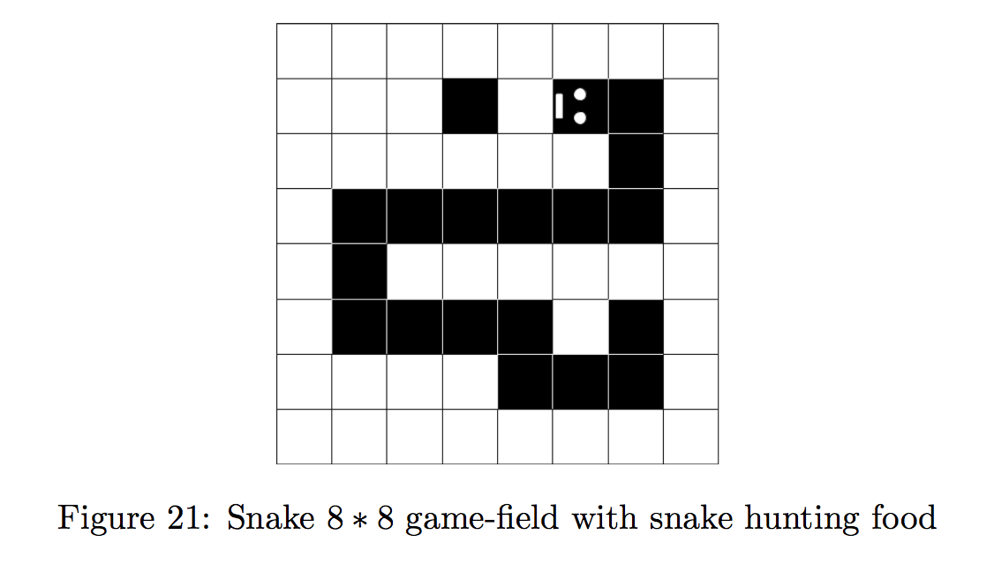

Slide 51
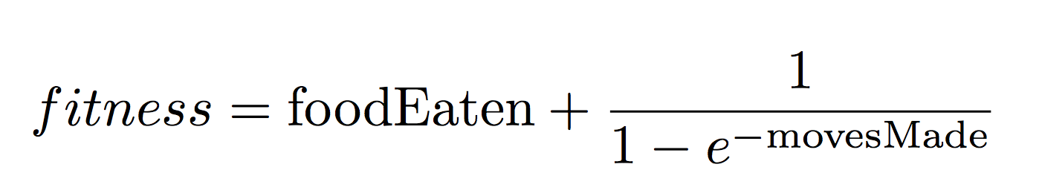
Notes:
Faster

Slide 52
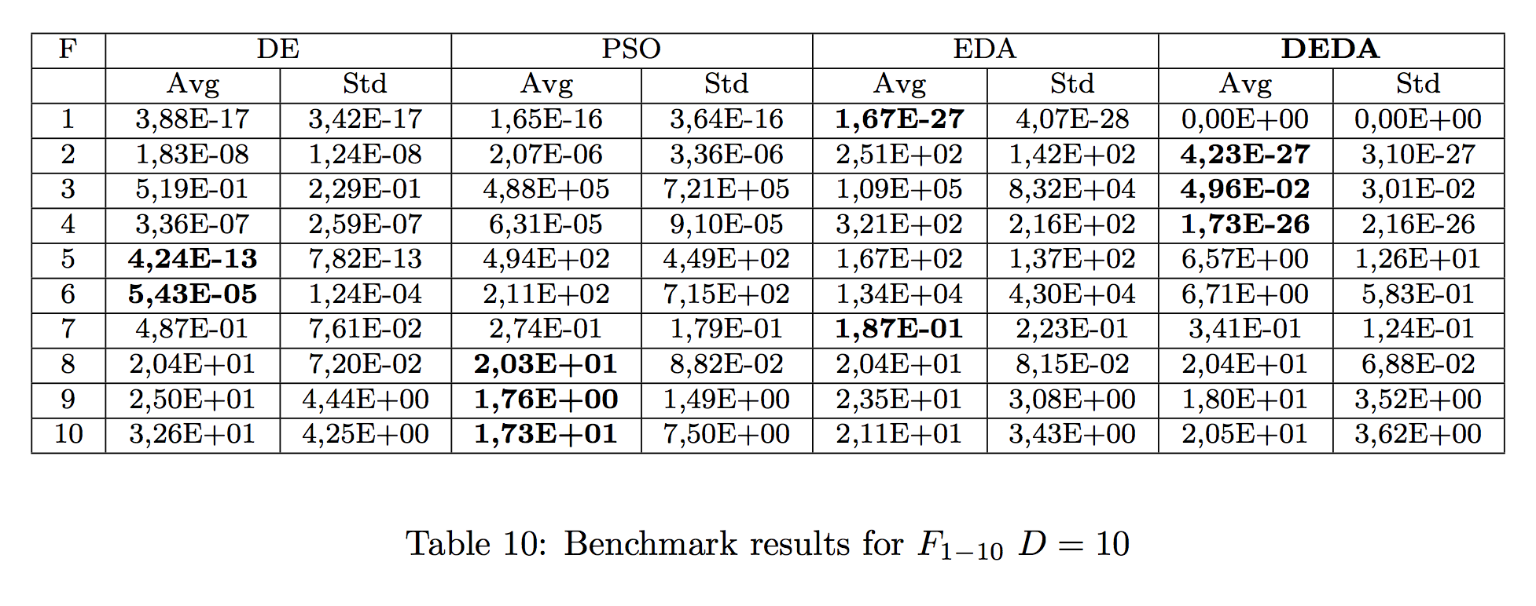
Function Optimization at D=10

Slide 53
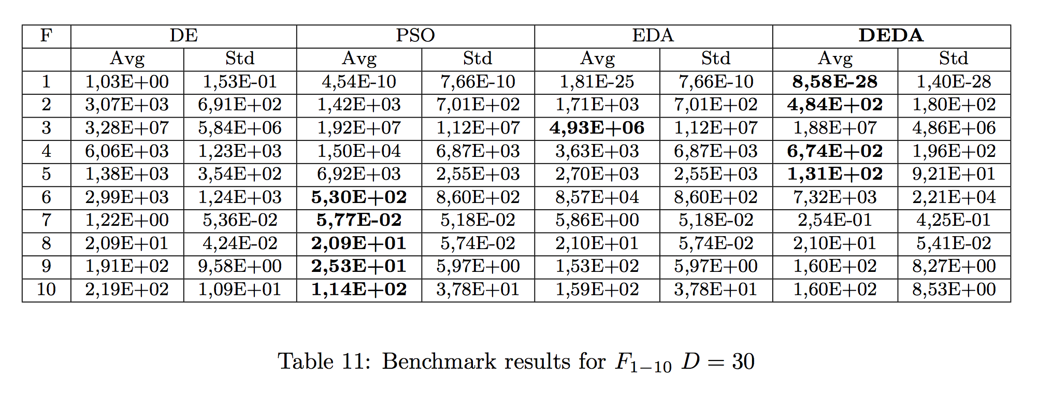
Function Optimization at D=30

Slide 54
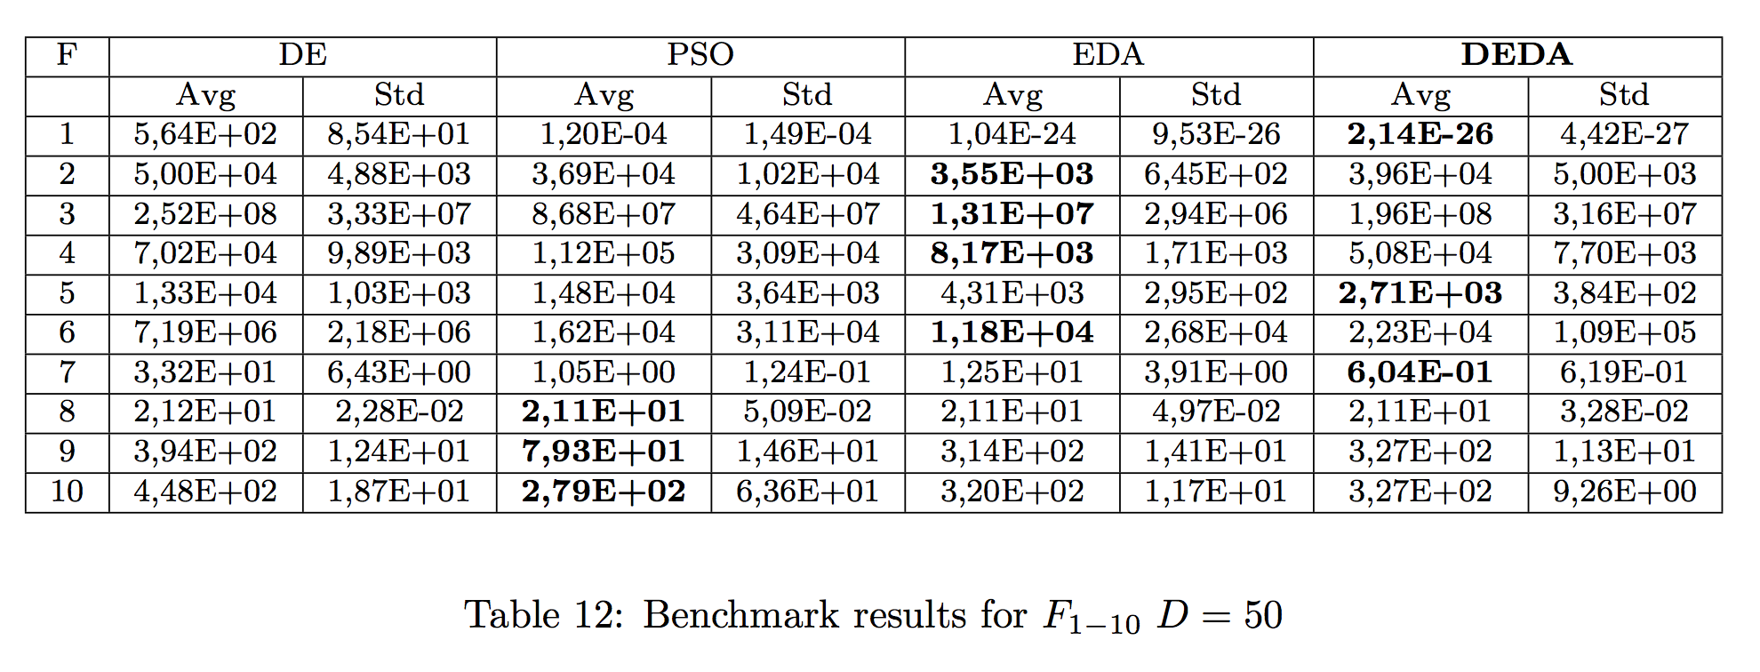
Function Optimization at D=50

Slide 55
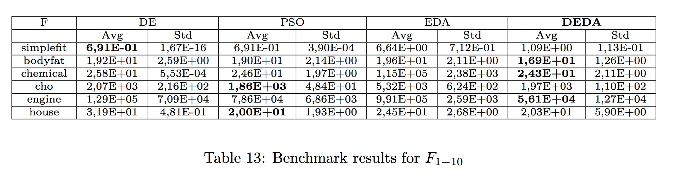
Function Approximation

Slide 56
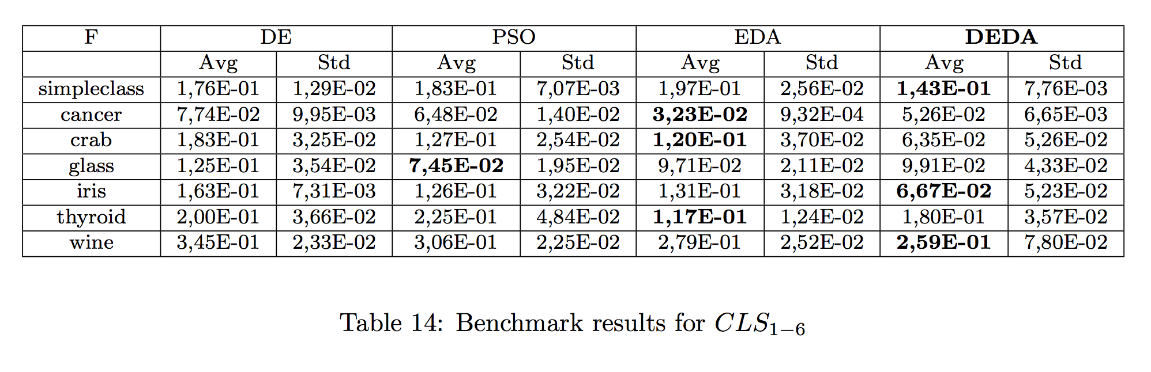
Classification

Slide 57
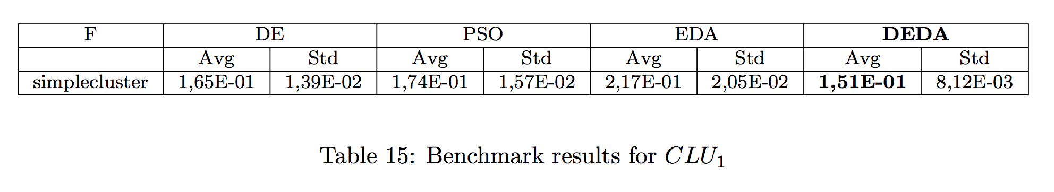
Clustering

Slide 58
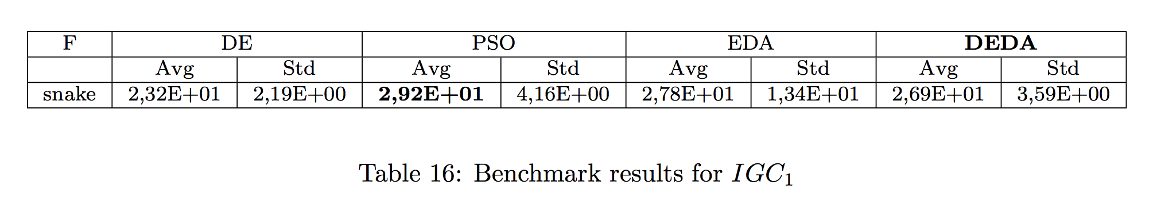
Intelligent Game Controllers

Slide 59
Discussion
All algorithms perform comparatively well
PSO and DEDA perform better then the rest on average
PSO is best at multimodal functions and game controllers
DEDA is best at unimodal functions and optimizing neural networks
EDA performs somewhat worse than DEDA
EDA performs well at higher dimensional mathematical optimization

Slide 60
Conclusions
The End

Slide 61
Two-Fold Conclusion
Benchmark
New Algorithm
DE, PSO, EDA and DEDA were compared on mathematical and ML benchmarks
PSO and DEDA were the best performers overall
DEDA showed good results in the benchmarks
Inspired by EDA
Extended mutation and recombination operator inspired by DE
Performed well at ML tasks (approximation, clustering, classification, etc.)

Slide 62
Future Work
What’s next?

Slide 63
Future Work
There exist many variations of the tested algorithms
It would be interesting to compare the different variations of the best performing algorithms in the benchmarks to try to improve performance
It would be interesting to try different approaches at hybridizing differential mutation and recombination with the principles of model building and distribution sampling to find the most efficient approach

Slide 64
The End
Questions?

